Slide 1
Pointers
Chapter 8 of C++ How to Program, 10/e

Slide 2
8.1 Introduction
Pointers are one of the most powerful, yet challenging to use, C++ capabilities.
We’ll discuss when it’s appropriate to use pointers, and show how to use them correctly and responsibly.
Pointers also enable pass-by-reference and can be used to create and manipulate pointer-based dynamic data structures.
We also show the intimate relationship among built-in arrays and pointers.

Slide 3
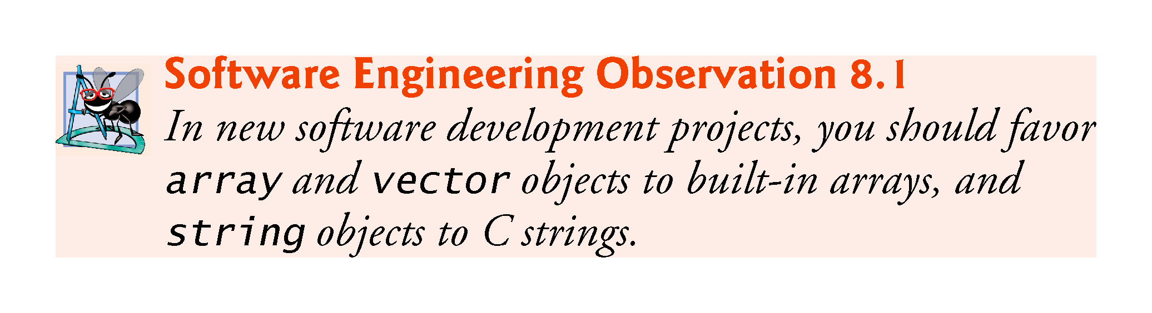

Slide 4
8.2 Pointer Variable Declarations and Initialization
A pointer contains the memory address of a variable that, in turn, contains a specific value.
In this sense, a variable name directly references a value, and a pointer indirectly references a value.
Referencing a value through a pointer is called indirection.
Diagrams typically represent a pointer as an arrow from the variable that contains an address to the variable located at that address in memory.

Slide 5
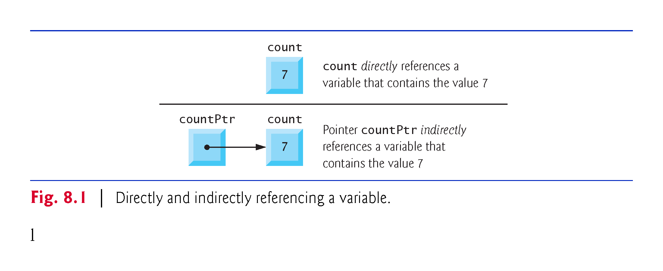

Slide 6
8.2.1 Memory addresses
Copy the following program
#include <iostream>
using namespace std;
int main()
{
int var1{5};
char var2{'w'};
double var3{5.234};
string var4{"How are you?"};
cout << &var1 << endl;
cout << &var2 << endl;
cout << &var3 << endl;
cout << &var4 << endl << endl;
}

Slide 7
8.2.1 Declaring Pointers
The declaration
int* countPtr, count;
declares the variable countPtr to be of type int* (i.e., a pointer to an int value) and is read (right to left), “countPtr is a pointer to int.”
Variable count in the preceding declaration is declared to be an int, not a pointer to an int.
The * in the declaration applies only to countPtr.
Each variable being declared as a pointer must be preceded by an asterisk (*).
When * appears in a declaration, it is not an operator—it indicates that the variable being declared is a pointer.
Pointers can be declared to point to objects of any type.

Slide 8
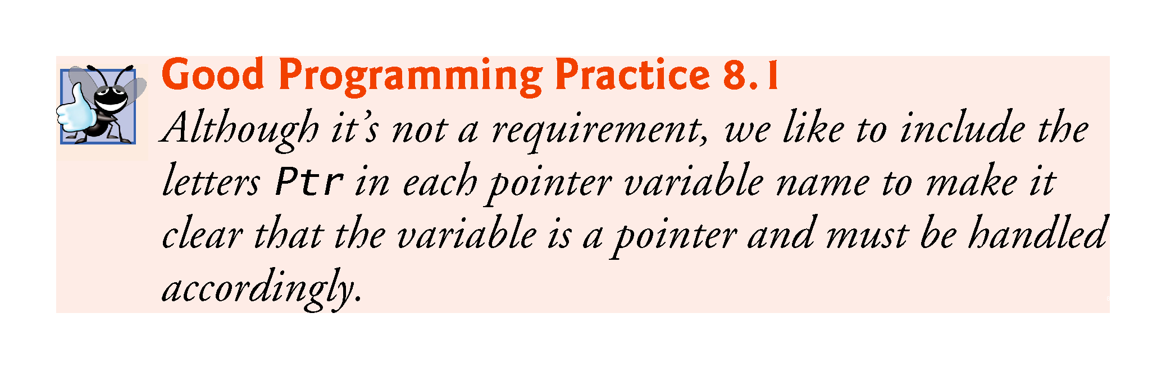

Slide 9
8.2.2 Initializing Pointers
Pointers should be initialized to nullptr (new in C++11) or to a memory either when they’re declared or in an assignment.
A pointer with the value nullptr “points to nothing” and is known as a null pointer.
From this point forward, when we refer to a “null pointer” we mean a pointer with the value nullptr.

Slide 10
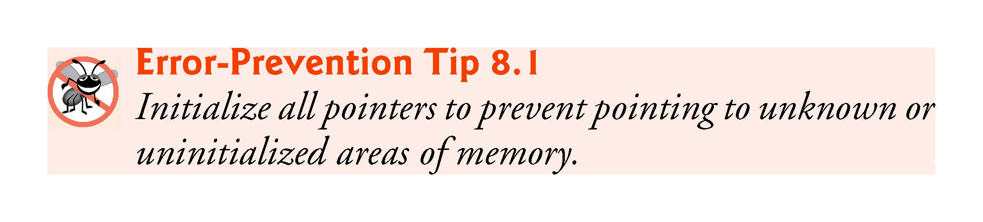

Slide 11
8.2.3 Null Pointers Prior to C++11
In earlier versions of C++, the value specified for a null pointer was 0 or NULL.
NULL is defined in several standard library headers to represent the value 0.
Initializing a pointer to NULL is equivalent to initializing a pointer to 0, but prior to C++11, 0 was used by convention.
The value 0 is the only integer value that can be assigned directly to a pointer variable without first casting the integer to a pointer type.

Slide 12
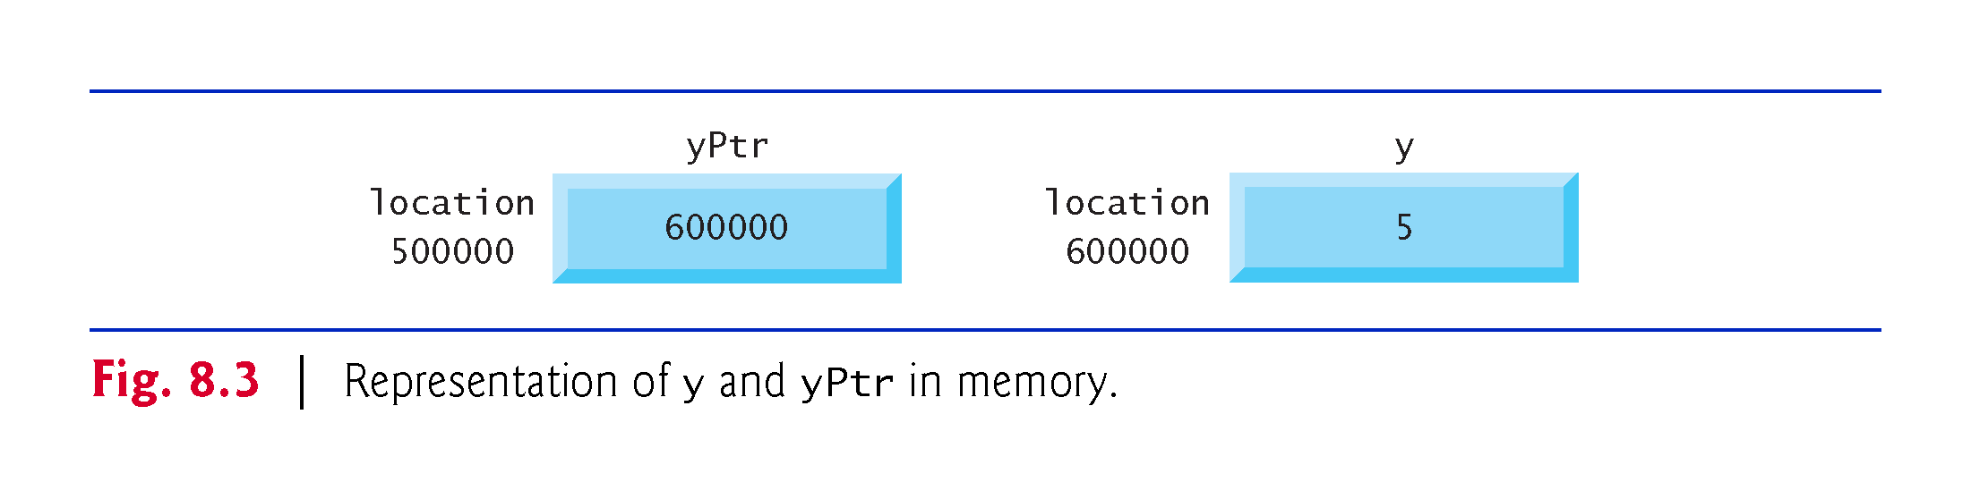

Slide 13
8.3.2 Indirection (*) Operator
The unary * operator—commonly referred to as the indirection operator or dereferencing operator—returns an lvalue representing the object to which its pointer operand points.
Called dereferencing a pointer
A dereferenced pointer may also be used as an lvalue on the left side of an assignment.

Slide 14
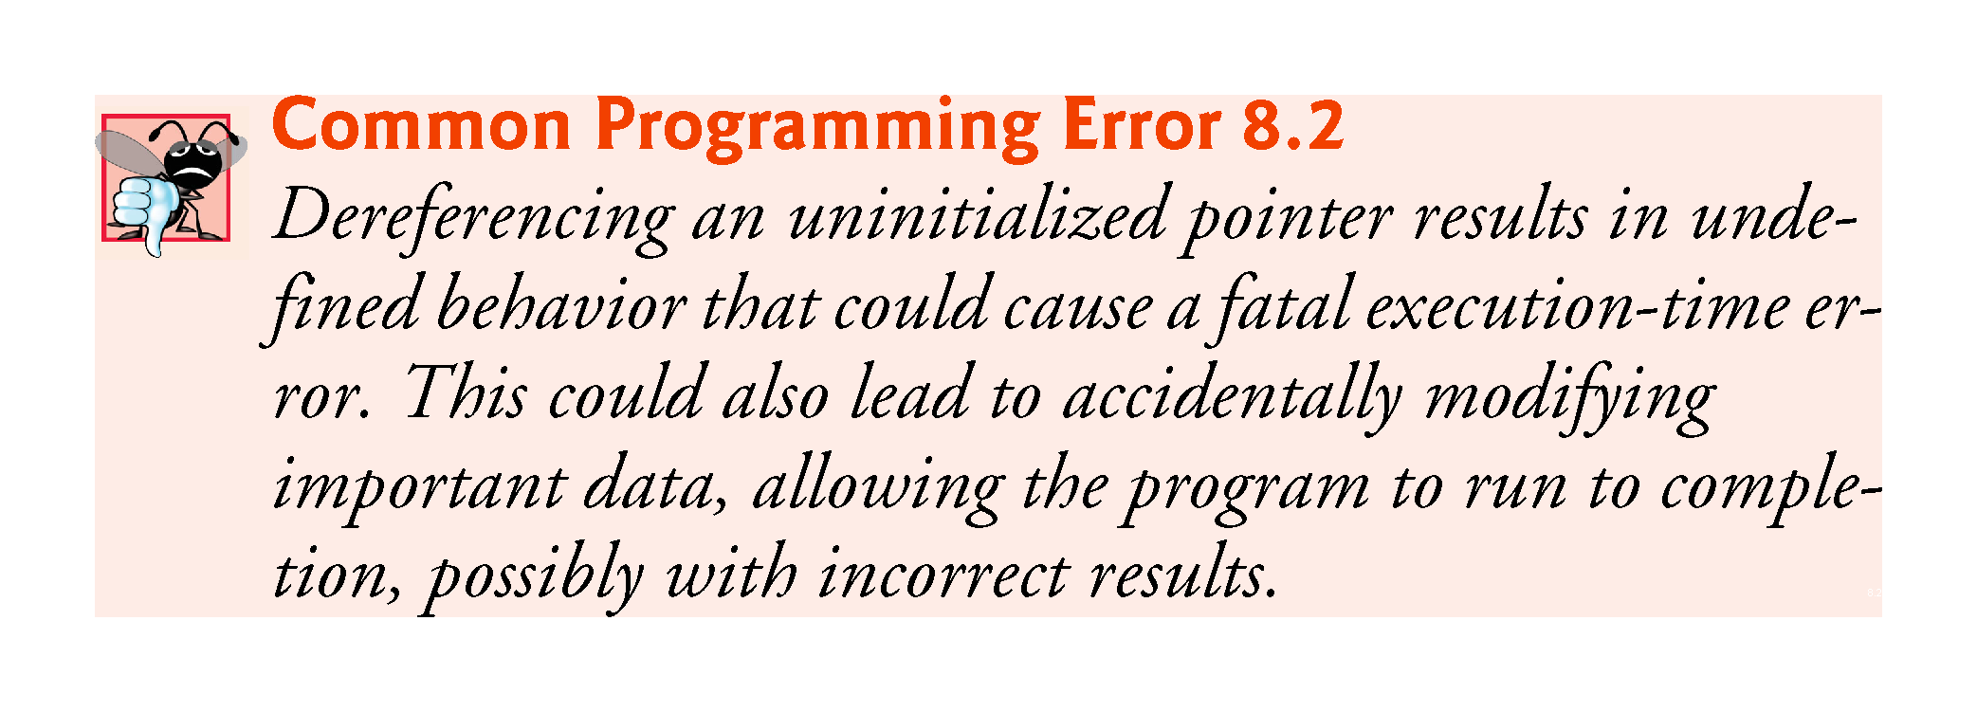

Slide 15
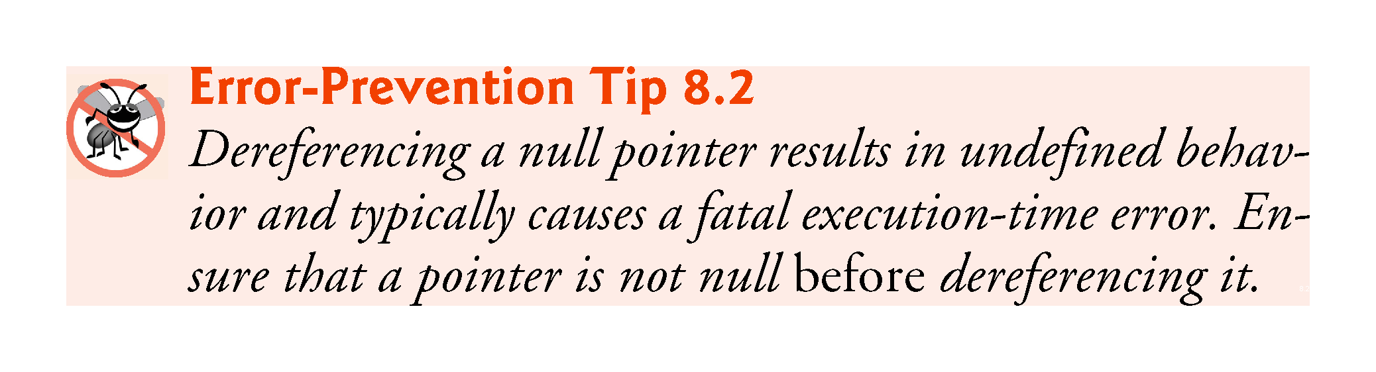

Slide 16
8.3.3 Exercise
Define a double variable var. Initialize it to 6.57.
Print the value of var.
Print the address of that variable.
Define a pointer varPtr pointing to var.
Print the value of varPtr (that is, cout << varPtr;).
Print the dereferenced value of varPtr (using *).
Print the address of varPtr.
Write cout << *&var; what do you get?
Write cout << &*varPtr; what do you get?

Slide 17
8.4 Pass-by-Reference with Pointers
There are three ways in C++ to pass arguments to a function
pass-by-value
pass-by-reference with reference arguments
pass-by-reference with pointer arguments.
Here, we explain pass-by-reference with pointer arguments.

Slide 18
8.4 Exercises
For each of the following, write a single statement that performs the specified task. Assume that long variables value1 and value2 have been declared and value1 has been initialized to 200000.
Declare the variable longPtr to be a pointer to an object of type long.
Assign the address of variable value1 to pointer variable longPtr.
Print the value of the object pointed to by longPtr.
Assign the value of the object pointed to by longPtr to variable value2.
Print the value of value2.
Print the address of value1.
Print the address stored in longPtr. Is the value printed the same as value1’s address?

Slide 19
8.4 Pass-by-Reference with Pointers
Pointers can be used to modify one or more variables in the caller or to pass pointers to large data objects to avoid the overhead of copying the objects.
You can use pointers and the indirection operator (*) to accomplish pass-by-reference.
When calling a function with an argument that should be modified, the address of the argument is passed.

Slide 20
8.4 Pass-by-Reference with Pointers (cont.)
An Example of Pass-By-Value
Figure 8.6 passes variable number by value to function cubeByValue, which cubes its argument and passes the new value result back to main using a return statement.
The calling function has the opportunity to examine the function call’s result before modifying any variable’s values.

Slide 21
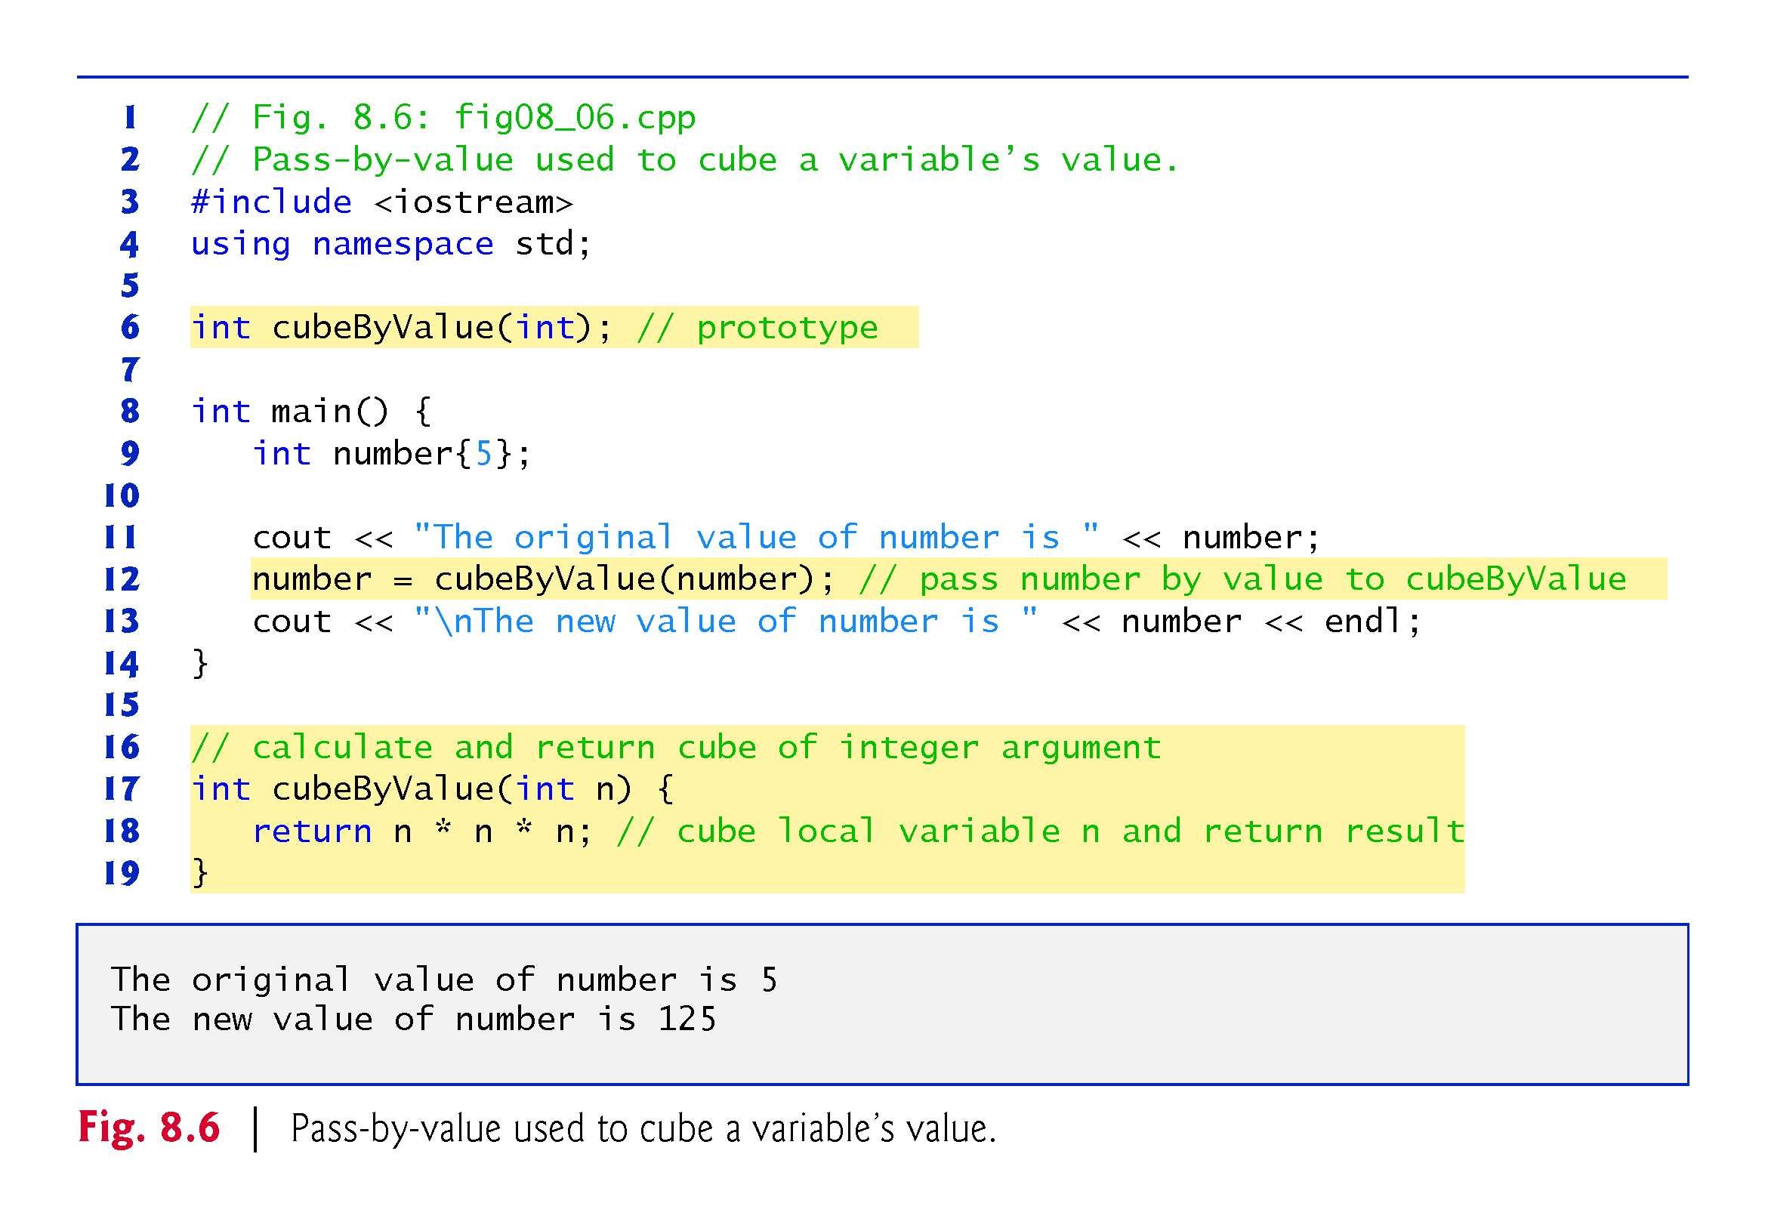

Slide 22
8.4 Pass-by-Reference with Pointers (cont.)
An Example of Pass-By-Reference with Pointers
Figure 8.7 passes the variable number to function cubeByReference using pass-by-reference with a pointer argument—the address of number is passed to the function.
The function uses the dereferenced pointer to cube the value to which nPtr points.
This directly changes the value of number in main.

Slide 23
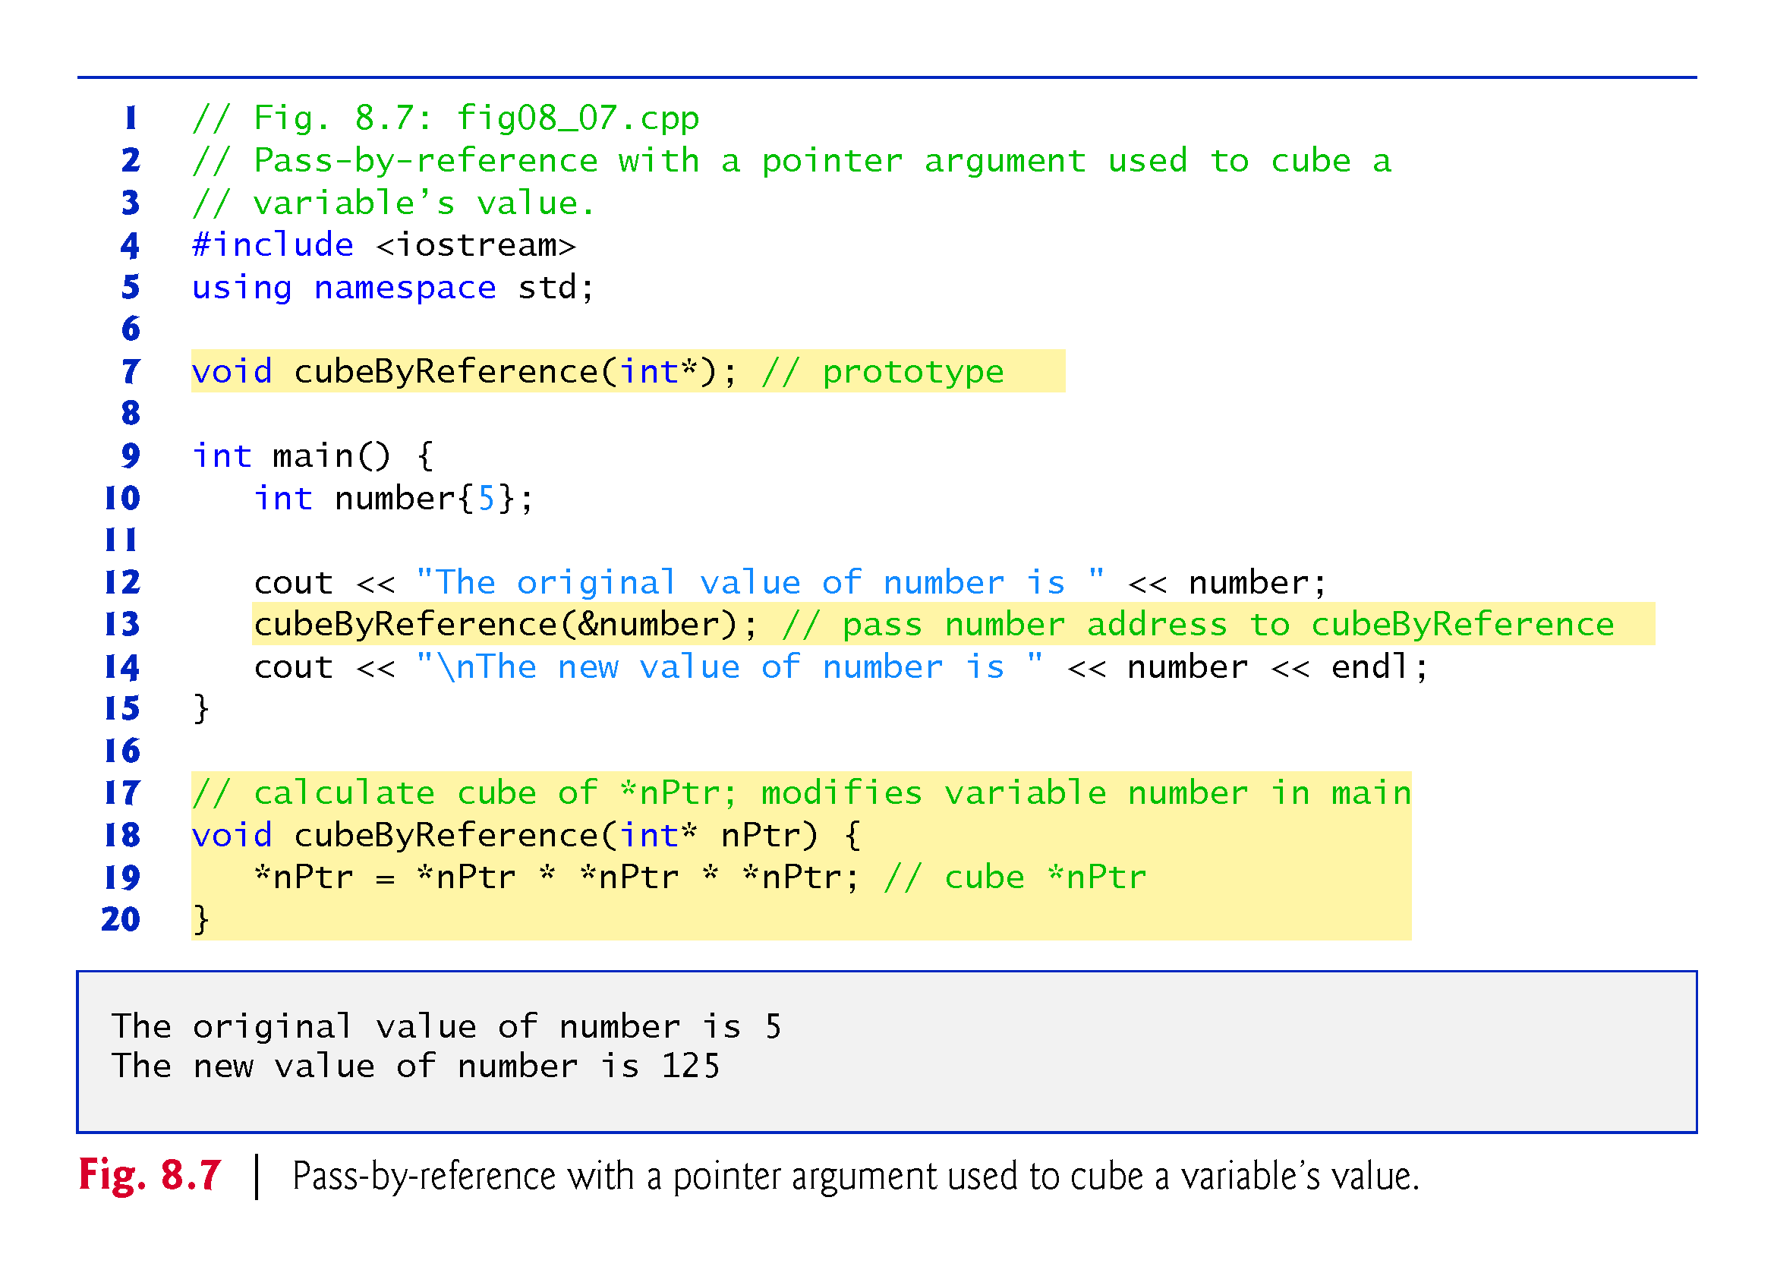

Slide 24
8.4 Pass-by-Reference with Pointers (cont.)
Insight: All Arguments Are Passed By Value
Passing a variable by reference with a pointer does not actually pass anything by reference—a pointer to that variable is passed by value and is copied into the function’s corresponding pointer parameter.
The called function can then access that variable in the caller simply by dereferencing the pointer, thus accomplishing pass-by-reference.

Slide 25
8.4 Pass-by-Reference with Pointers (cont.)
Graphical Analysis of Pass-By-Value and Pass-By-Reference
Figures 8.8–8.9 analyze graphically the execution of the programs in Fig. 8.6 and Fig. 8.7, respectively.
In the diagrams, the values in blue rectangles above a given expression or variable represent the value of that expression or variable.
Each diagram’s right column shows functions cubeByValue (Fig. 8.6) and cubeByReference (Fig. 8.7) only when they’re executing.

Slide 26
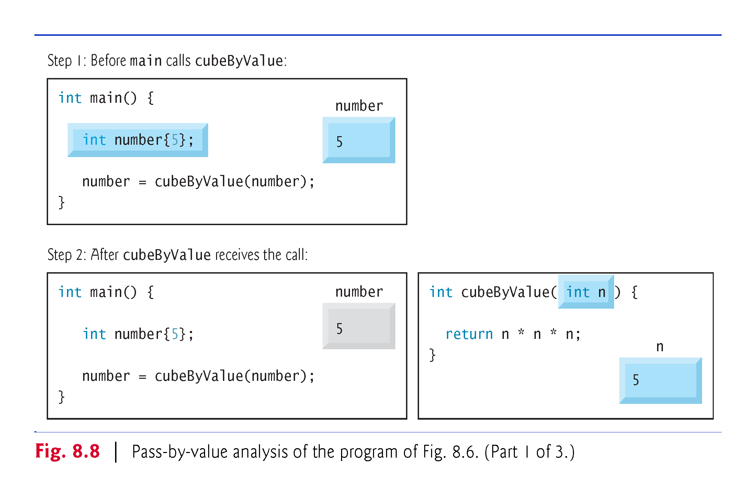

Slide 27
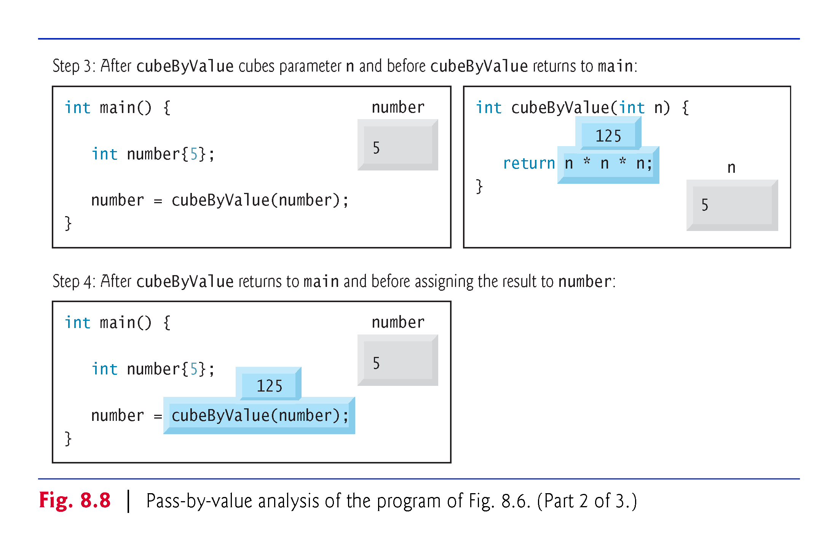

Slide 28
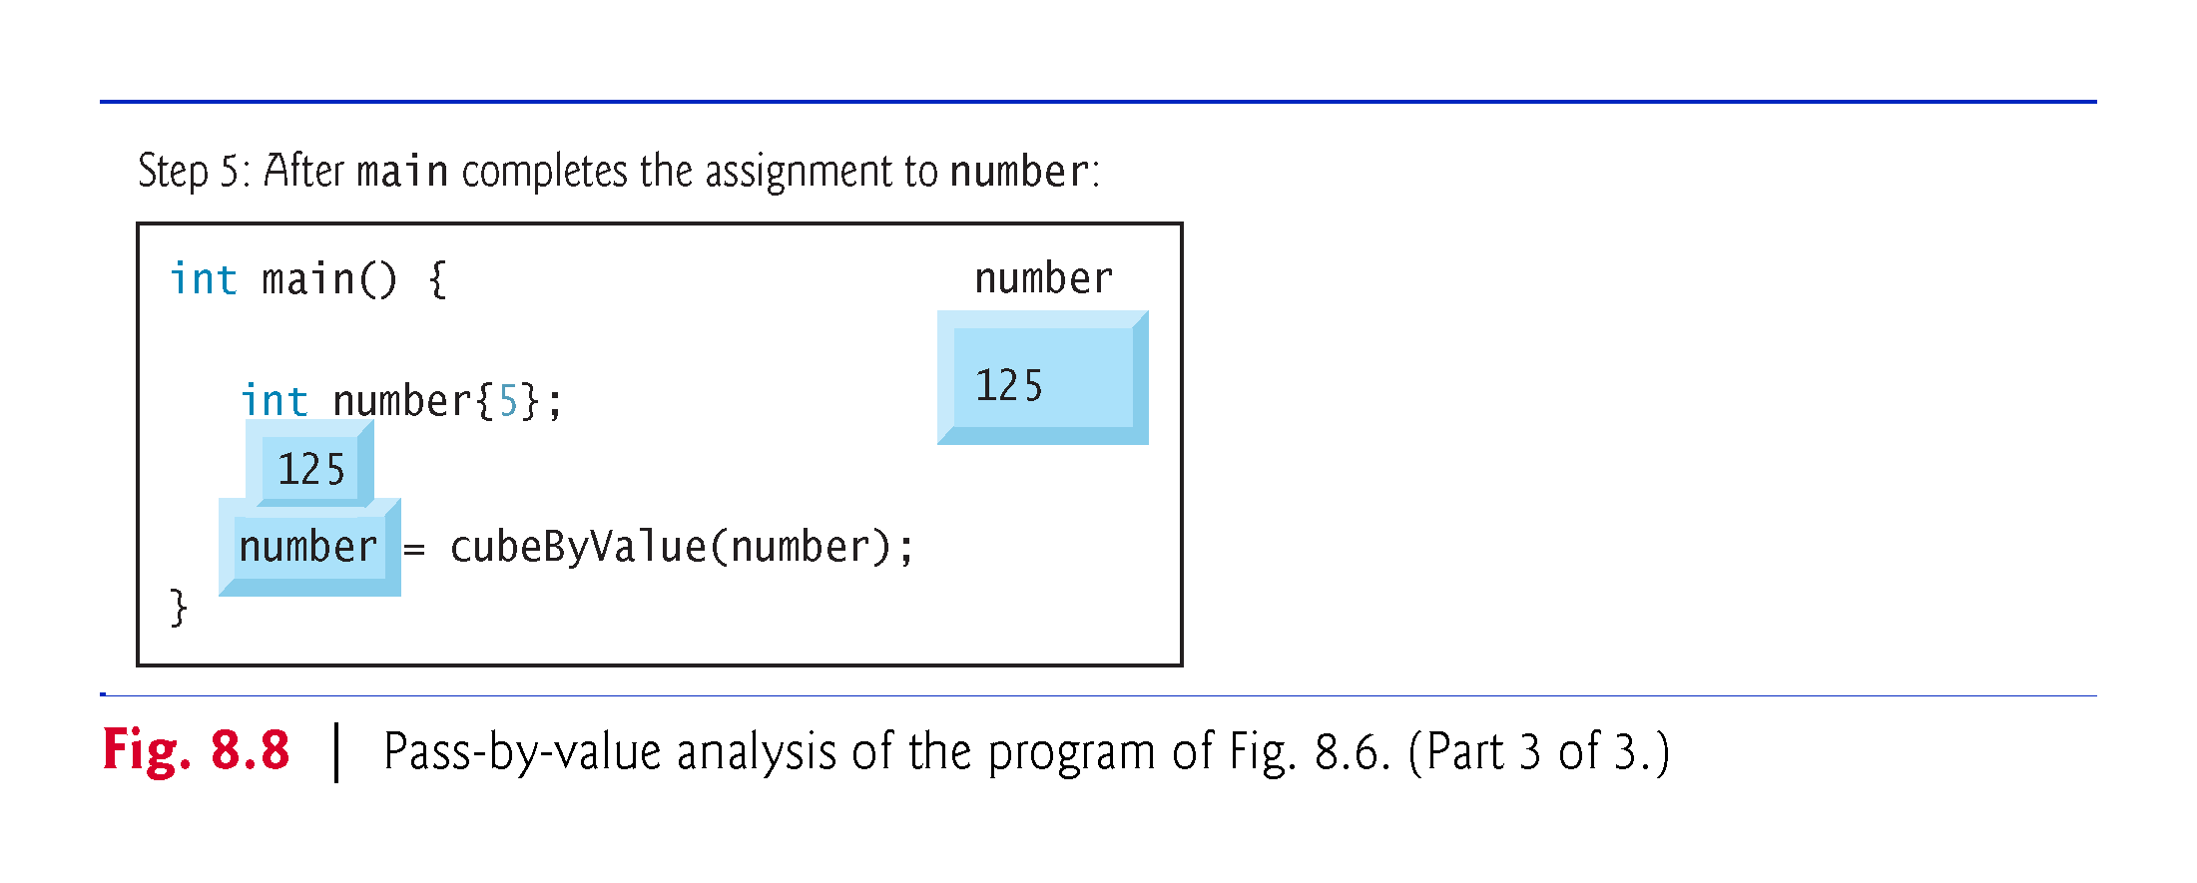

Slide 29
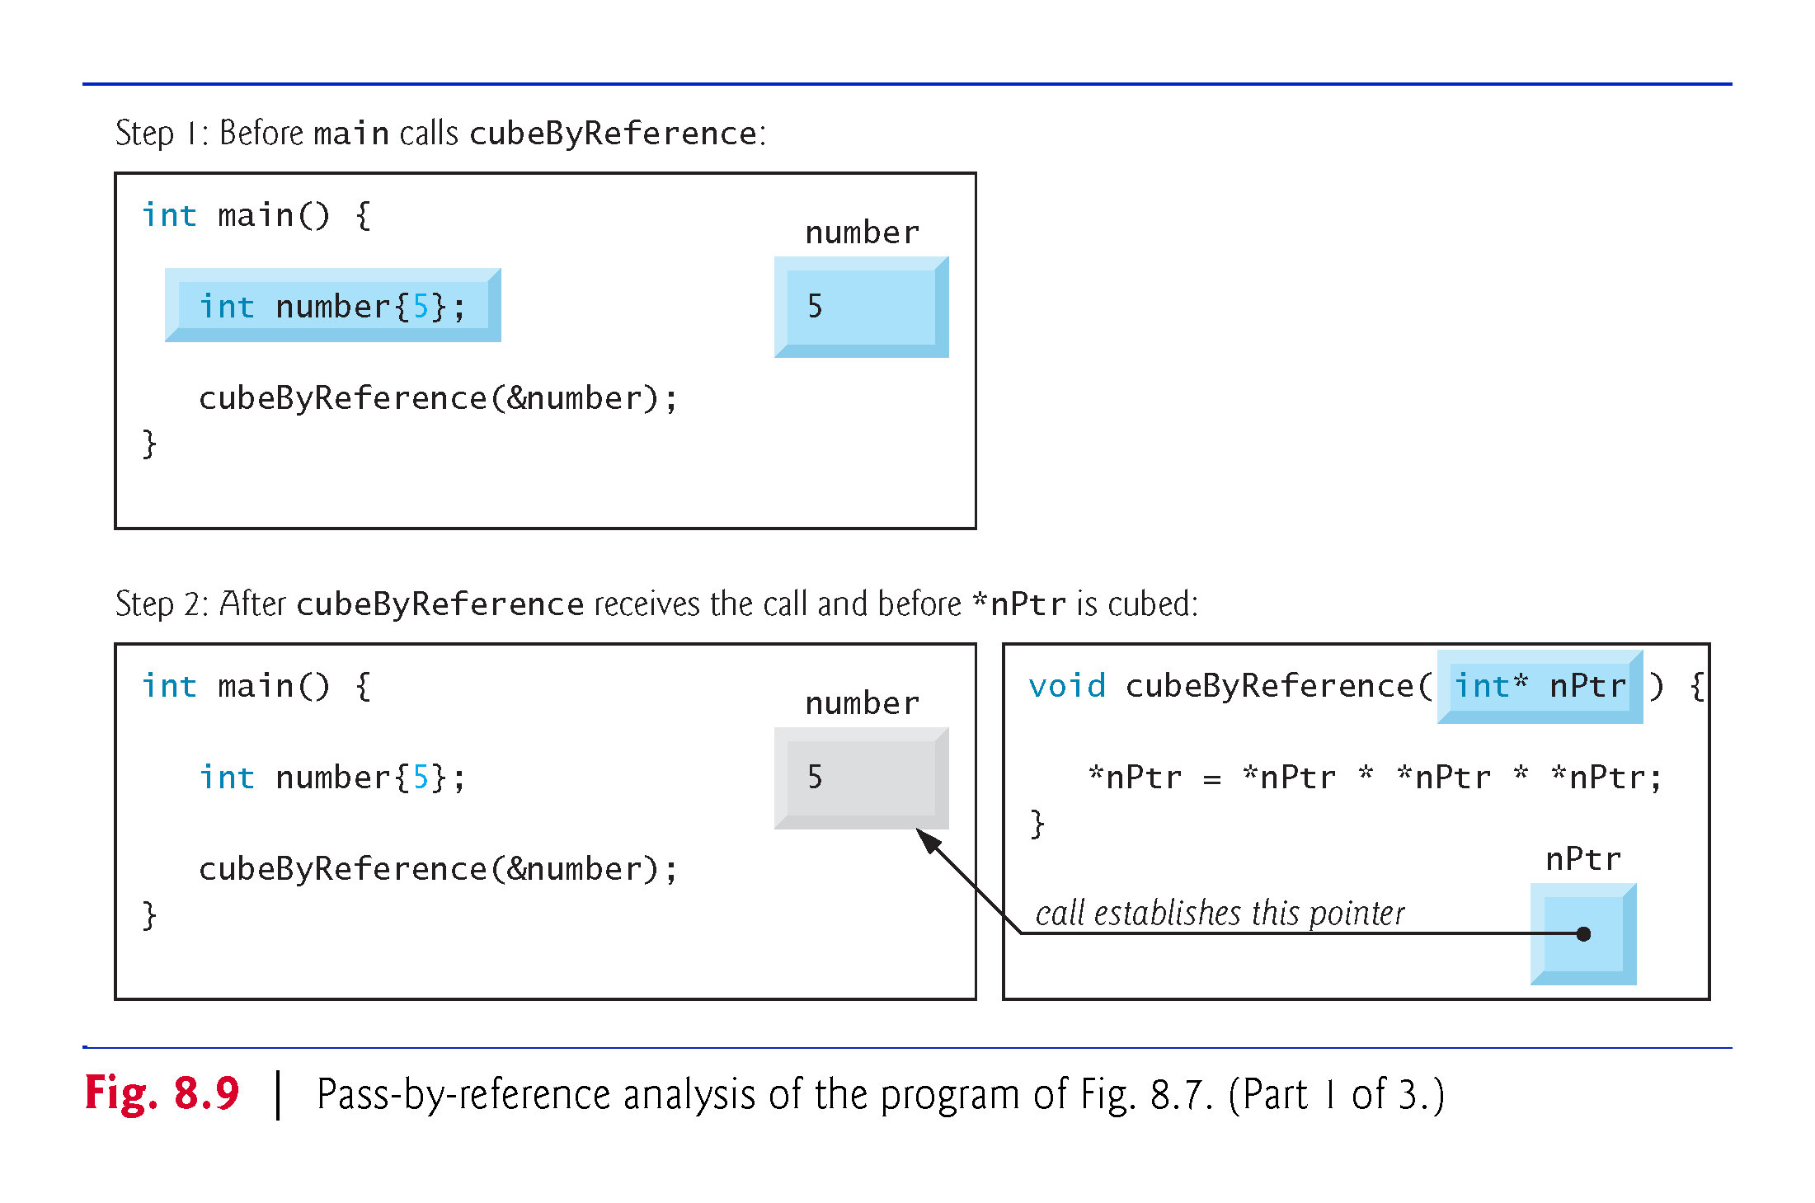

Slide 30
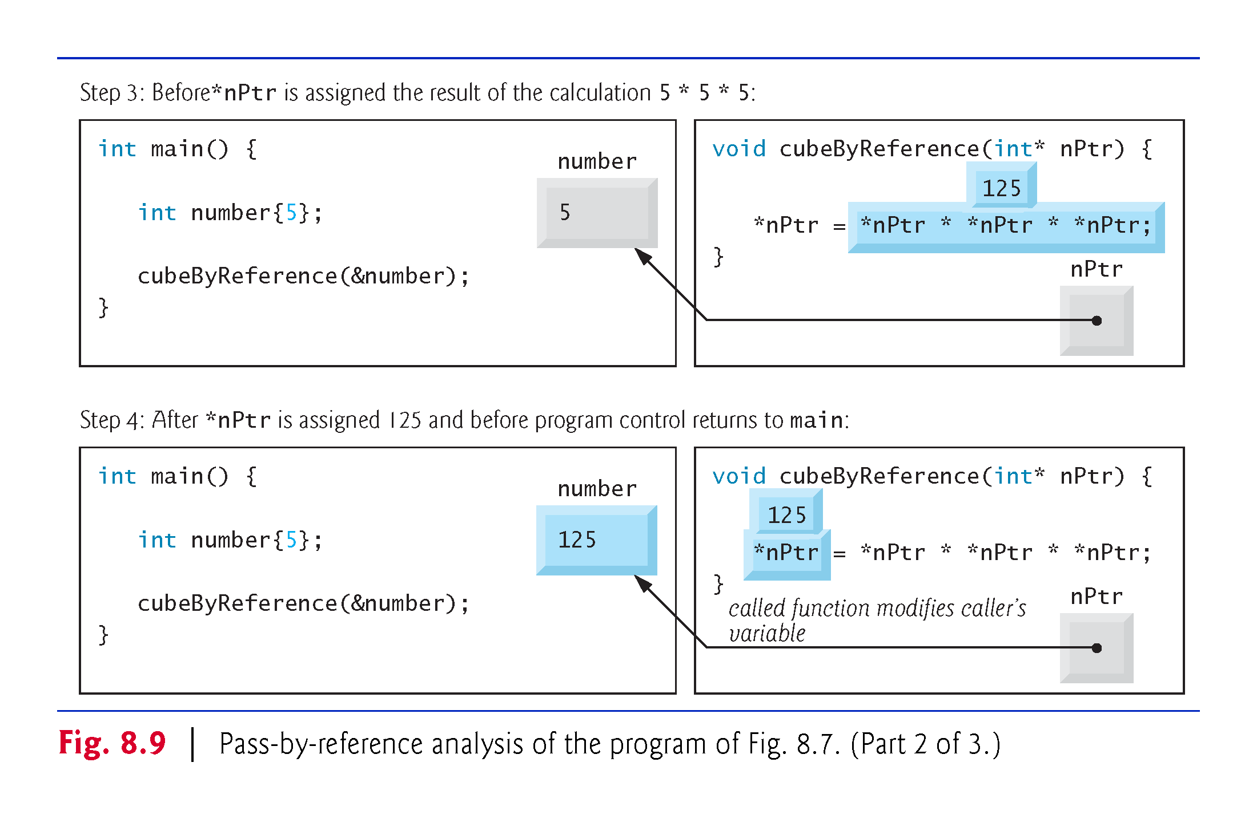

Slide 31
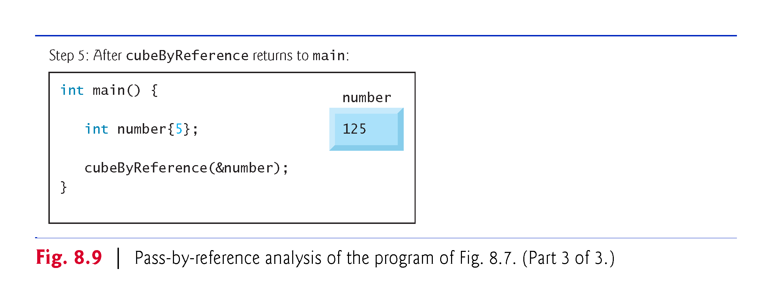

Slide 32
8.4 Exercises
Write functions squareByValue, squareByRef, squareByPointer that find the square of an integer, in three different ways:
squareByValue should return the square of the number, passing the argument by value.
squareByRef should modify the variable in the input to its square, passing by reference.
squareByPointer should also modify the variable in the input to its square, but passing the argument by pointer.

Slide 33
8.5 Built-In Arrays (called “bare-bone” in class)
Here we present built-in arrays, which are also fixed-size data structures.
To specify the type of the elements and the number of elements required by a built-in array, type arrayName[arraySize];
The compiler reserves the appropriate amount of memory.
arraySize must be an integer constant greater than zero.
To reserve 12 elements for built-in array of ints named c, use the declaration
int c[12];
As with array objects, you use the subscript ([]) operator to access the individual elements of a built-in array.

Slide 34
8.5.2 Initializing Built-In Arrays
You can initialize the elements of a built-in array using an initializer list as in
int n[5]{50, 20, 30, 10, 40};
creates a built-in array of five ints and initializes them to the values in the initializer list.
If you provide fewer initializers
the number of elements, the remaining elements are value initialized—fundamental numeric types are set to 0, bools are set to false, pointers are set to nullptr and class objects are initialized by their default constructors.
If you provide too many initializers a compilation error occurs.

Slide 35
8.5.2 Initializing Built-In Arrays
If a built-in array’s size is omitted from a declaration with an initializer list, the compiler sizes the built-in array to the number of elements in the initializer list.
For example,
int n[]{50, 20, 30, 10, 40};
creates a five-element array.

Slide 36
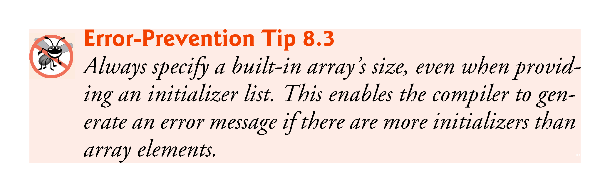

Slide 37
8.5.5 C++11: Standard Library Functions begin and end
Function sort (and many other C++ Standard Library functions) can also be applied to built-in arrays.
For example, to sort the built-in array n shown earlier in this section, you can write:
// sort contents of built-in array n
sort(begin(n), end(n));

Slide 38
8.5.6 Built-In Array Limitations
Built-in arrays have several limitations:
They cannot be compared using the relational and equality operators—you must use a loop to compare two built-in arrays element by element.
They cannot be assigned to one another.
They don’t know their own size—a function that processes a built-in array typically receives both the built-in array’s name and its size as arguments.
They don’t provide automatic bounds checking—you must ensure that array-access expressions use subscripts that are within the built-in array’s bounds.

Slide 39
8.5.7 Built-In Arrays Sometimes Are Required
There are cases in which built-in arrays must be used, such as processing a program’s command-line arguments.
You supply command-line arguments to a program by placing them after the program’s name when executing it from the command line. Such arguments typically pass options to a program.
Also, a limitation of C++ is that a function cannot have an array as output. However, pointers can be the output of a function, and essentially an array is a pointer to its first element. For example: (pointers07)

Slide 40
8.4.8 Exercises
Define an int built-in array basic1 with 5 elements: 1, 4, 5, 6, 8.
Use a for loop to print the contents of basic1.
Define a char array alphabet whose elements are all the letters of the alphabet in lowercase. How can you do this efficiently?
Use a for loop to print the contents of alphabet.
Try to use alphabet.size(). Does it work?
Find the address of alphabet[0], alphabet[1], and alphabet[2].
Write cout << sizeof(alphabet); What do you get?
Write cout << sizeof(basic1); What do you get?

Slide 41
8.6 Using const with Pointers
Many possibilities exist for using (or not using) const with function parameters.
Principle of least privilege
Always give a function enough access to the data in its parameters to accomplish its specified task, but no more.

Slide 42
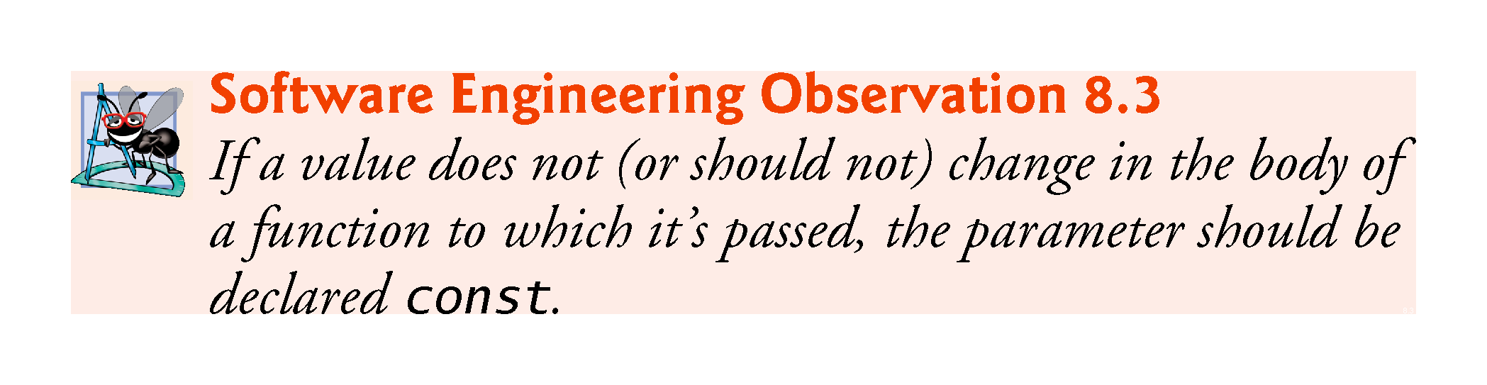
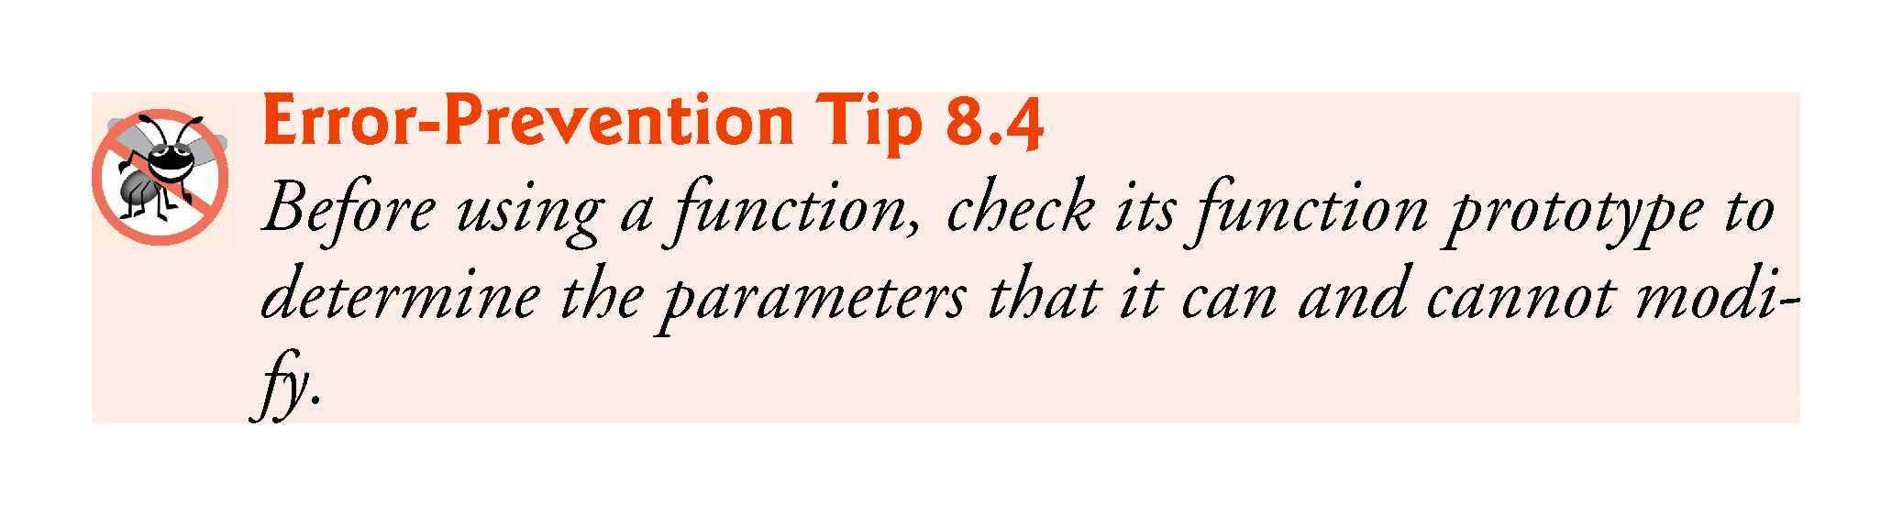

Slide 43
8.6 Using const with Pointers (cont.)
There are four ways to pass a pointer to a function
a nonconstant pointer to nonconstant data
a nonconstant pointer to constant data (Fig. 8.10)
a constant pointer to nonconstant data (Fig. 8.11)
a constant pointer to constant data (Fig. 8.12)
Each combination provides a different level of access privilege.

Slide 44
8.7 sizeof Operator
The unary operator sizeof determines the size in bytes of a built-in array or of any other data type, variable or constant during program compilation.
When applied to a built-in array’s name, as in Fig. 8.13, the sizeof operator returns the total number of bytes in the built-in array as a value of type size_t.

Slide 45
8.7 sizeof Operator (cont.)
To determine the number of elements in the built-in array numbers, use the following expression (which is evaluated at compile time) :
sizeof numbers / sizeof(numbers[0])
The expression divides the number of bytes in numbers by the number of bytes in the built-in array’s zeroth element.

Slide 46
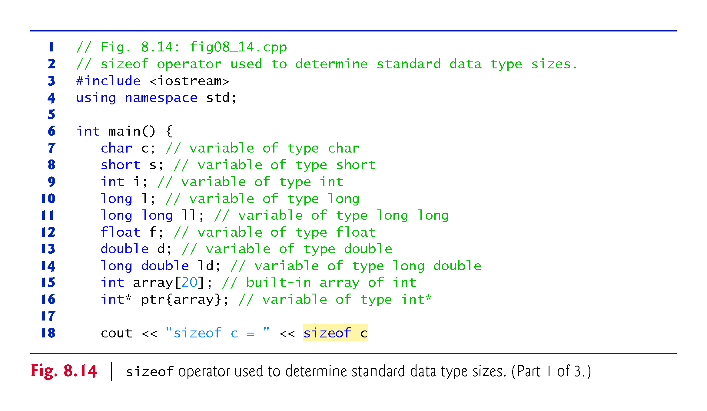

Slide 47
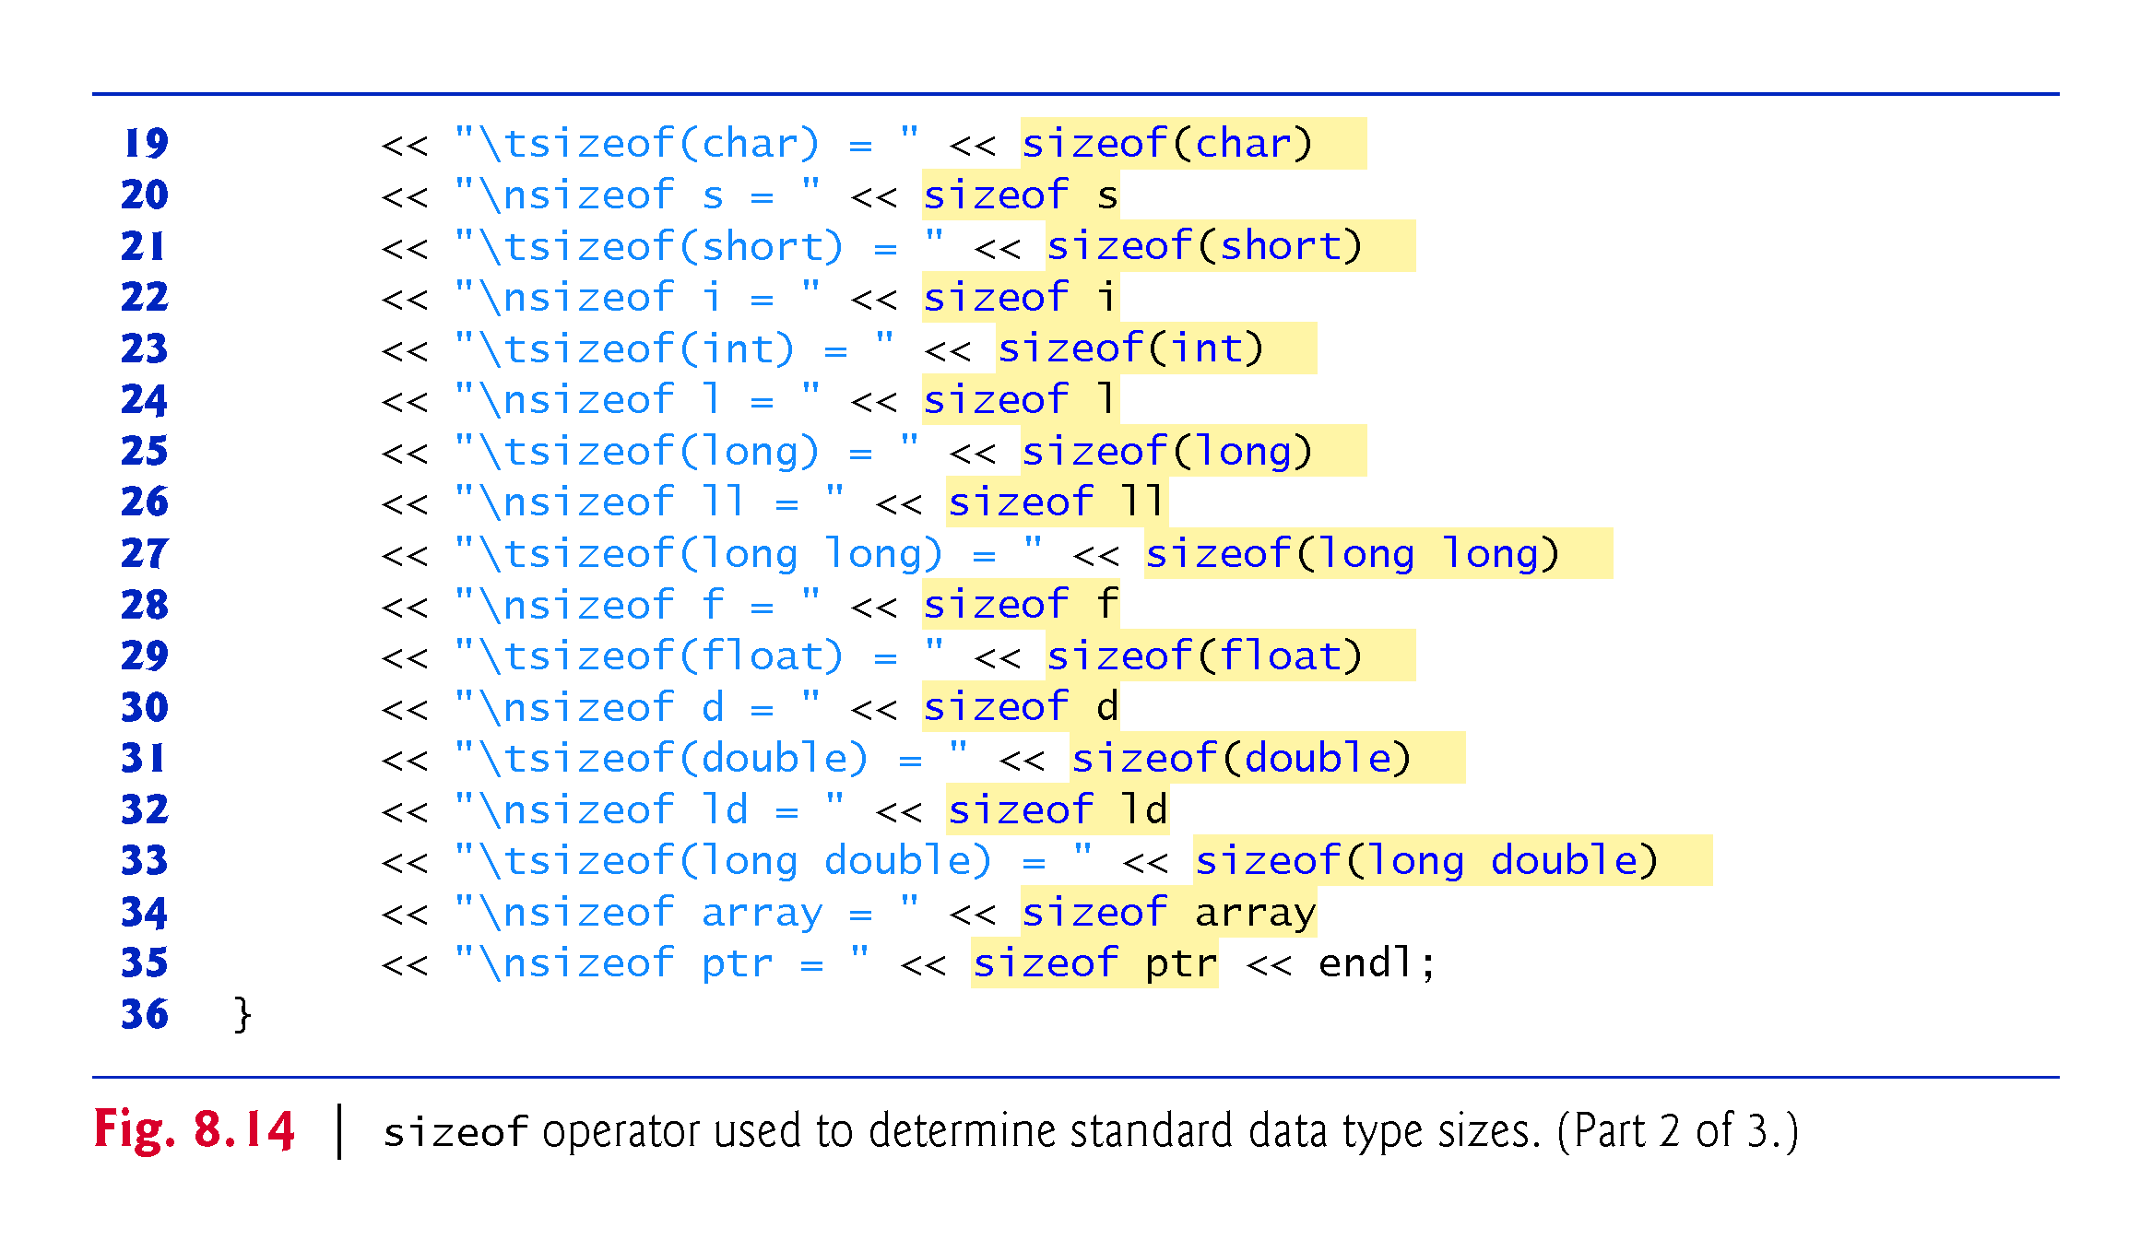

Slide 48
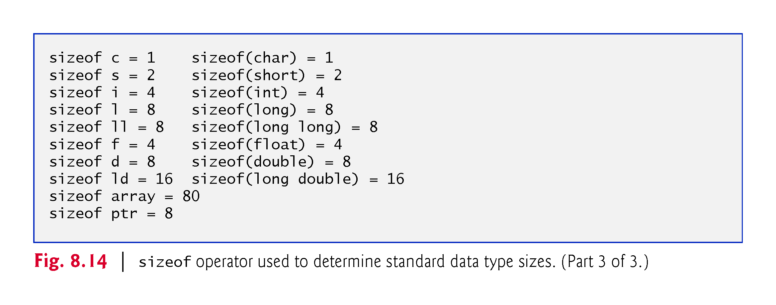

Slide 49
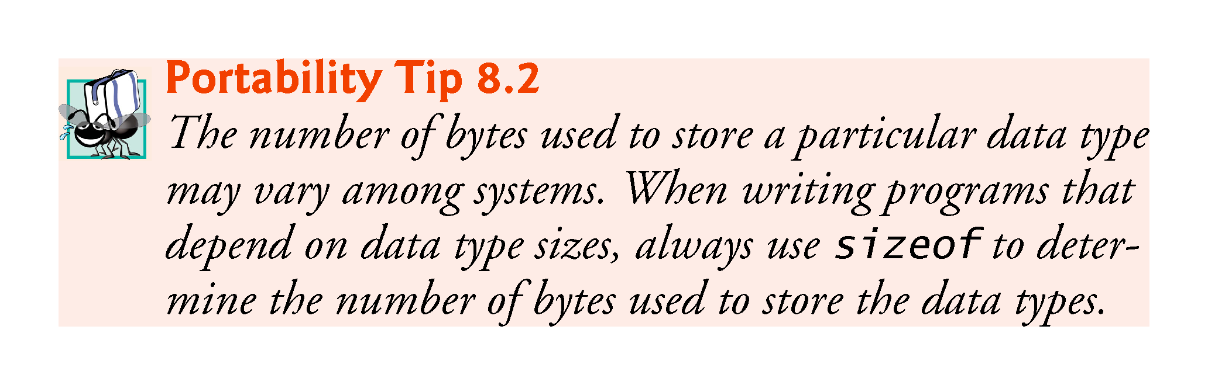

Slide 50
8.7 sizeof Operator (cont.)
Operator sizeof can be applied to any expression or type name.
When sizeof is applied to a variable name (which is not a built-in array’s name) or other expression, the number of bytes used to store the specific type of the expression is returned.
The parentheses used with sizeof are required only if a type name is supplied as its operand.

Slide 51
8.8 Pointer Expressions and Pointer Arithmetic
Pointers are valid operands in arithmetic expressions, assignment expressions and comparison expressions.
C++ enables pointer arithmetic—a few arithmetic operations may be performed on pointers:
increment (++)
decremented (--)
an integer may be added to a pointer (+ or +=)
an integer may be subtracted from a pointer (- or -=)
one pointer may be subtracted from another of the same type—this particular operation is appropriate only for two pointers that point to elements of the same built-in array

Slide 52
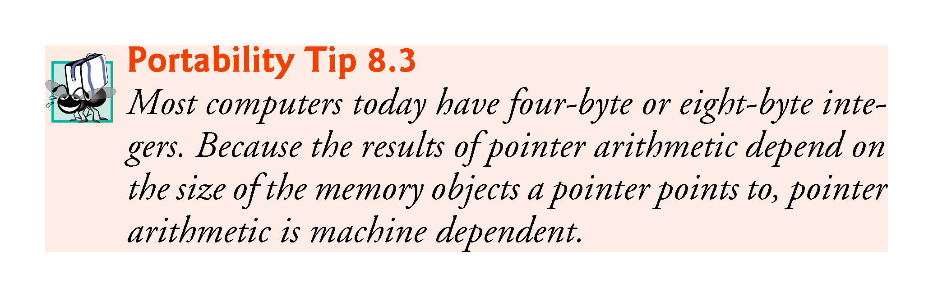

Slide 53
8.8 Pointer Expressions and Pointer Arithmetic
Assume that int v[5] has been declared and that its first element is at memory location 3000.
Assume that pointer vPtr has been initialized to point to v[0] (i.e., the value of vPtr is 3000).
Figure 8.15 diagrams this situation for a machine with four-byte integers. Variable vPtr can be initialized to point to v with either of the following statements:
int* vPtr{v};
int* vPtr{&v[0]};

Slide 54
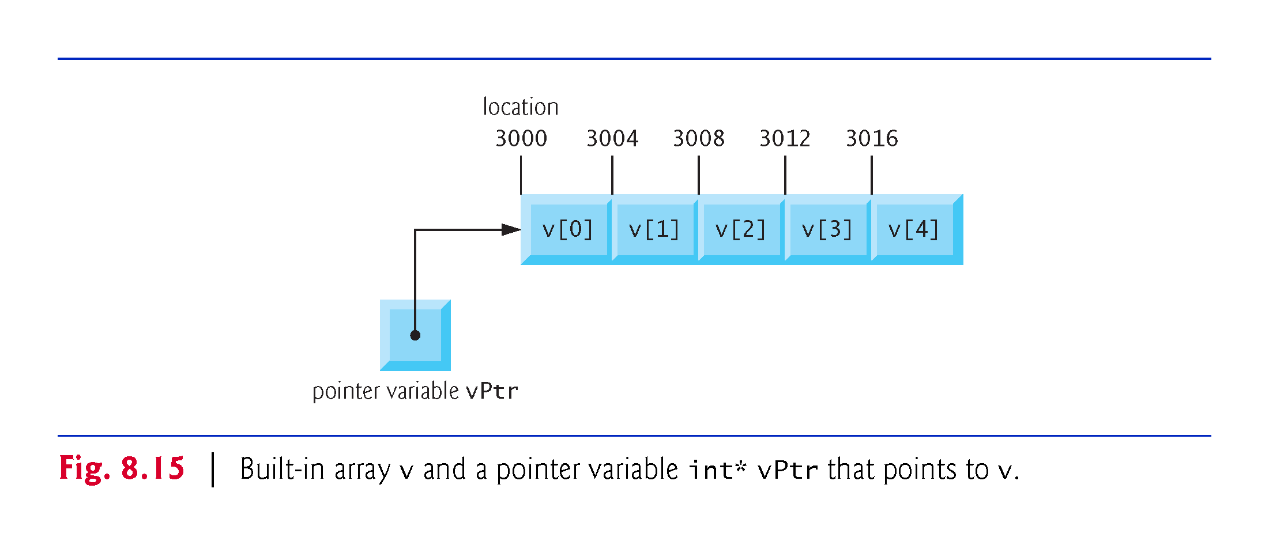

Slide 55
8.8.1 Adding Integers to and Subtracting Integers from Pointers
In conventional arithmetic, the addition 3000 + 2 yields the value 3002.
This is normally not the case with pointer arithmetic.
When an integer is added to, or subtracted from, a pointer, the pointer is not simply incremented or decremented by that integer, but by that integer times the size of the memory object to which the pointer refers.
The number of bytes depends on the memory object’s data type.

Slide 56
8.8.1 Adding Integers to and Subtracting Integers from Pointers
vPtr += 2;
would produce 3008 (from the calculation 3000 + 2 * 4), assuming that an int is stored in four bytes of memory.
In the built-in array v, vPtr would now point to v[2] (Fig. 8.16).
If an integer is stored in eight bytes of memory, then the preceding calculation would result in memory location 3016 (3000 + 2 * 8).

Slide 57
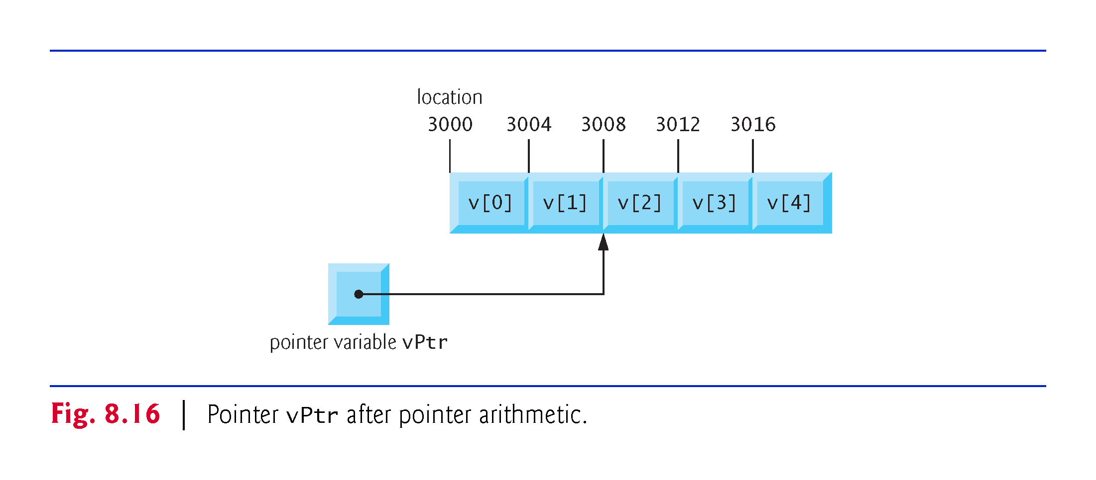

Slide 58
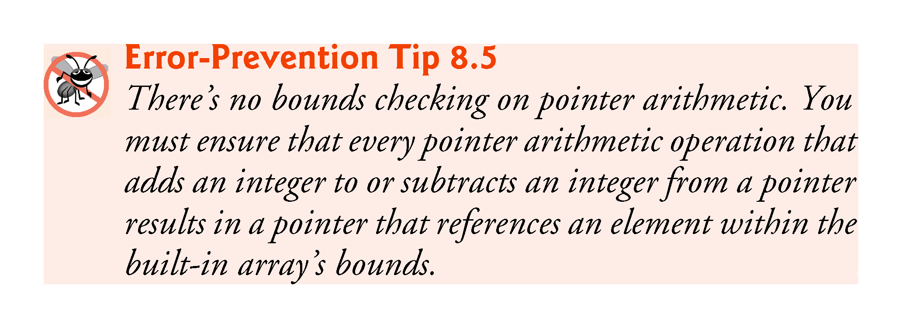

Slide 59
8.8.3 Subtracting Pointers
Pointer variables pointing to the same built-in array may be subtracted from one another.
For example, if vPtr contains the address 3000 and v2Ptr contains the address 3008, the statement
x = v2Ptr - vPtr;
would assign to x the number of built-in array elements from vPtr to v2Ptr—in this case, 2.
Pointer arithmetic is meaningful only on a pointer that points to a built-in array.

Slide 60
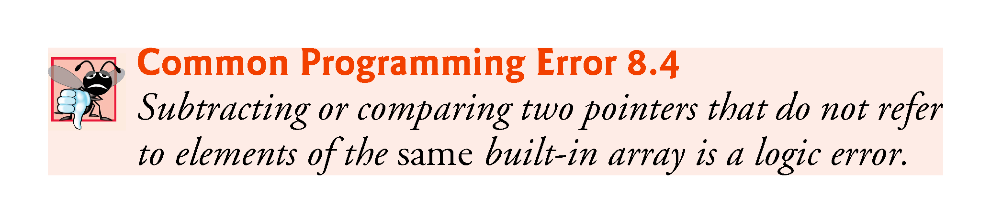

Slide 61
8.8.3 Pointer Assignment
A pointer can be assigned to another pointer if both pointers are of the same type.
Otherwise, a cast operator (normally a reinterpret_cast; discussed in Section 14.7) must be used to convert the value of the pointer on the right of the assignment to the pointer type on the left of the assignment.
Exception to this rule is the pointer to void (i.e., void*).
Any pointer to a fundamental type or class type can be assigned to a pointer of type void* without casting.

Slide 62
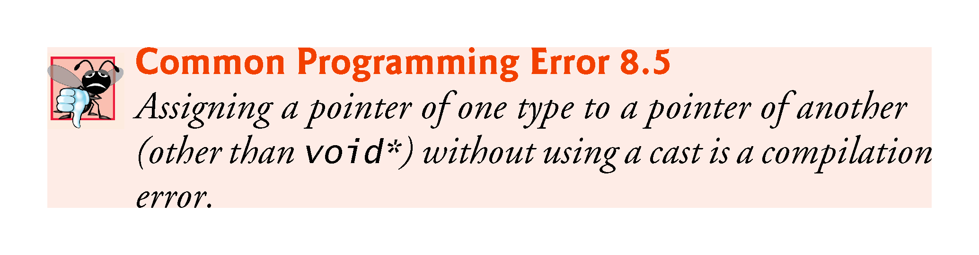

Slide 63
8.8.4 Cannot Dereference a void*
A void* pointer cannot be dereferenced.
The compiler “knows” that an int* points to four bytes of memory on a machine with four-byte integers—dereferencing an int* creates an lvalue that is an alias for the int’s four bytes in memory.
A void* simply contains a memory address for an unknown data type.
You cannot dereference a void* because the compiler does not know the type of the data to which the pointer refers and thus not the number of bytes.

Slide 64
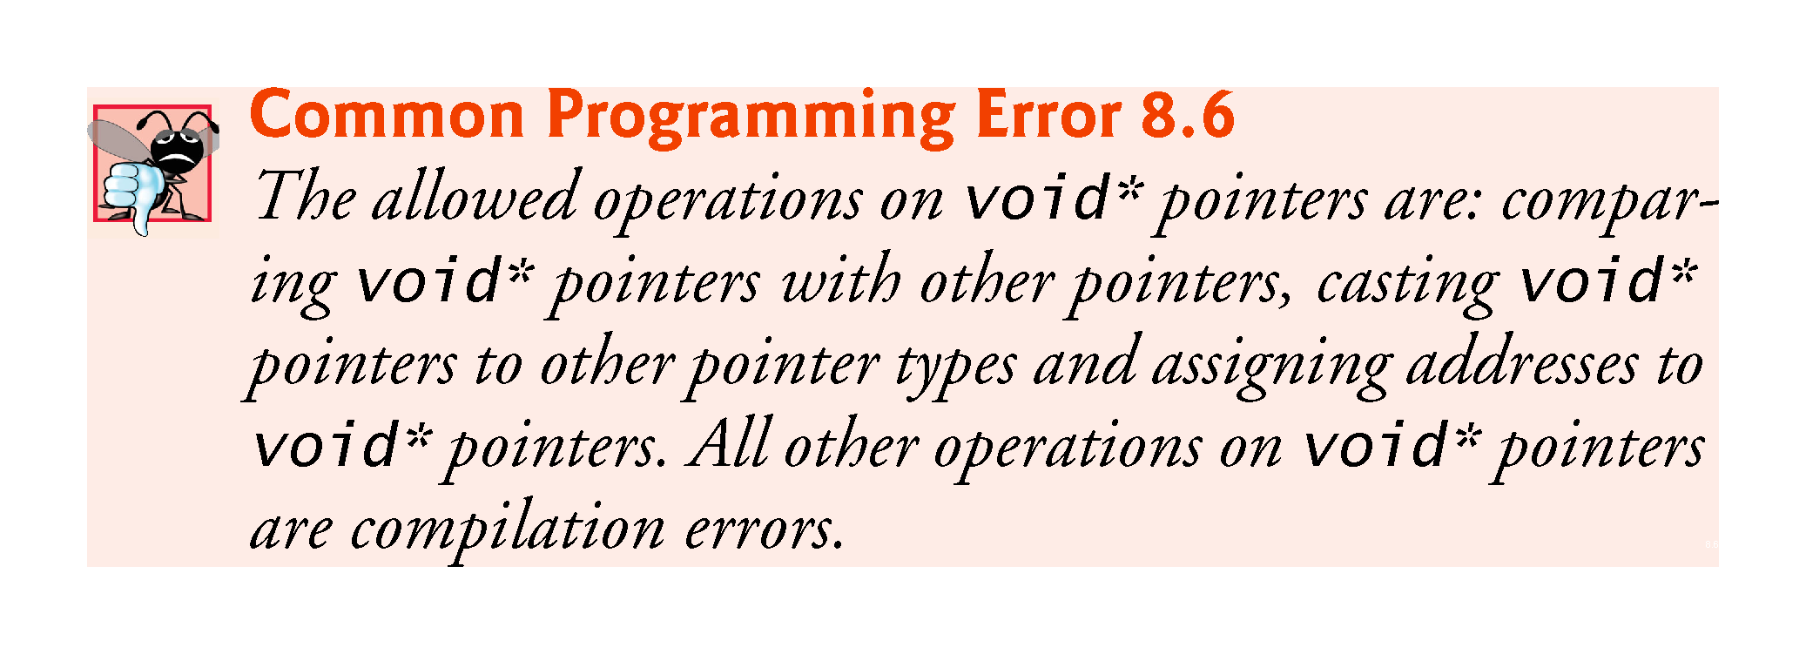

Slide 65
8.8.5 Comparing Pointers
Pointers can be compared using equality and relational operators.
Comparisons using relational operators are meaningless unless the pointers point to elements of the same built-in array.
Pointer comparisons compare the addresses stored in the pointers.
A common use of pointer comparison is determining whether a pointer has the value nullptr, 0 or NULL (i.e., the pointer does not point to anything).

Slide 66
8.9 Relationship Between Pointers and Built-In Arrays
Pointers can be used to do any operation involving array subscripting.
Assume the following declarations:
// create 5-element int array b; b is a const pointer
int b[5]; // create int pointer bPtr, which isn't a const pointer
int* bPtr;

Slide 67
8.9 Relationship Between Pointers and Built-In Arrays
We can set bPtr to the address of the first element in the built-in array b with the statement
// assign address of built-in array b to bPtr
bPtr = b;
This is equivalent to assigning the address of the first element as follows:
// also assigns address of built-in array b to bPtr
bPtr = &b[0];

Slide 68
8.9.1 Pointer/Offset Notation
Built-in array element b[3] can alternatively be referenced with the pointer expression
*(bPtr + 3)
The 3 in the preceding expression is the offset to the pointer.
This notation is referred to as pointer/offset notation.
The parentheses are necessary, because the precedence of * is higher than that of +.

Slide 69
8.9 Relationship Between Pointers and Built-In Arrays (cont.)
Just as the built-in array element can be referenced with a pointer expression, the address
&b[3]
can be written with the pointer expression
bPtr + 3

Slide 70
8.9.2 Pointer/Offset Notation with the Built-In Array’s Name as the Pointer
The built-in array name can be treated as a pointer and used in pointer arithmetic.
For example, the expression
*(b + 3)
also refers to the element b[3].
In general, all subscripted built-in array expressions can be written with a pointer and an offset.

Slide 71
8.9.3 Pointer/Subscript Notation
Pointers can be subscripted exactly as built-in arrays can.
For example, the expression
bPtr[1]
refers to b[1]; this expression uses pointer/subscript notation.

Slide 72
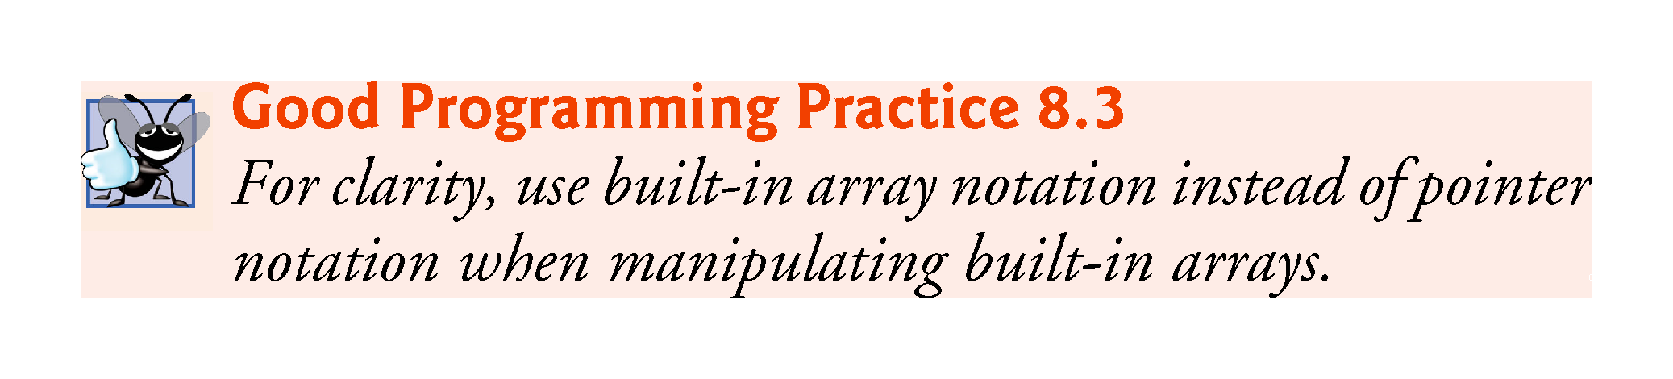

Slide 73
8.9.4 Demonstrating the Relationship Between Pointers and Built-In Arrays
Figure 8.17 uses the four notations we just discussed
array subscript notation
pointer/offset notation with the built-in array’s name as a pointer
pointer subscript notation
pointer/offset notation with a pointer
to accomplish the same task, namely displaying the four elements of the built-in array of ints named b.

Slide 74
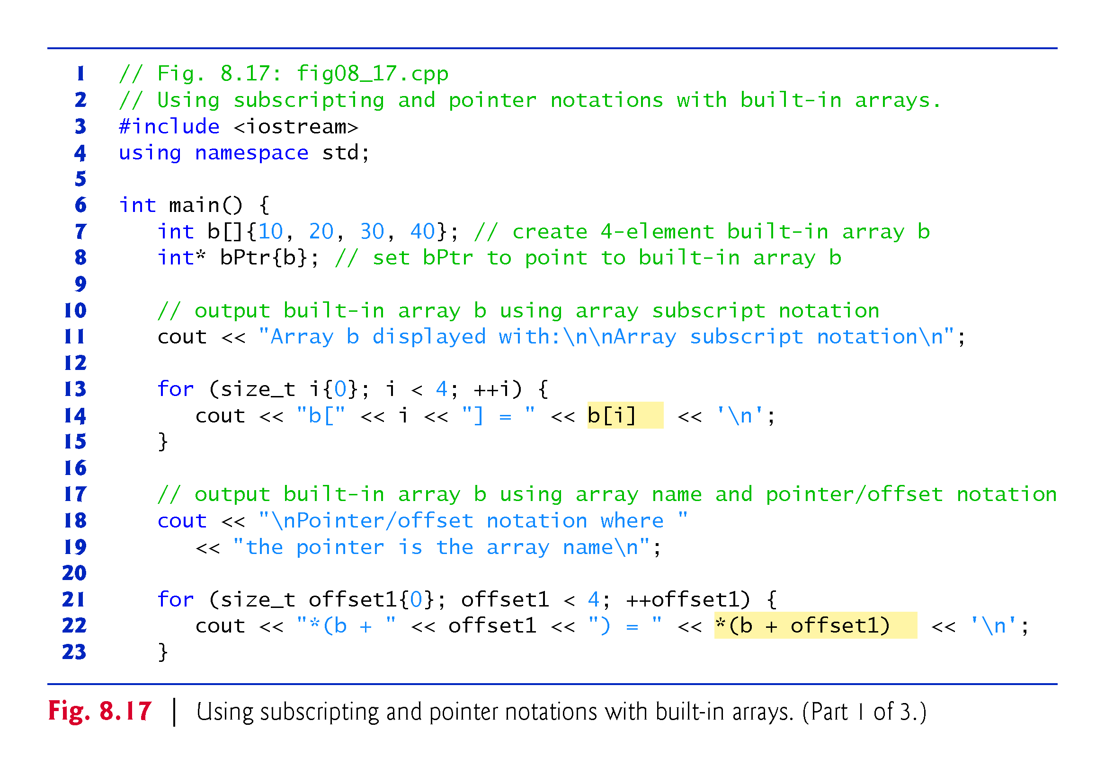

Slide 75
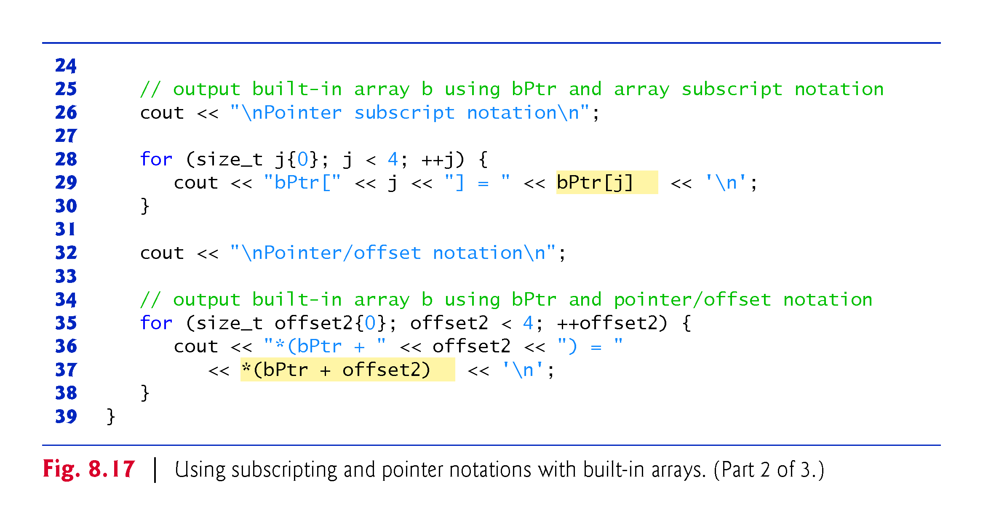

Slide 76
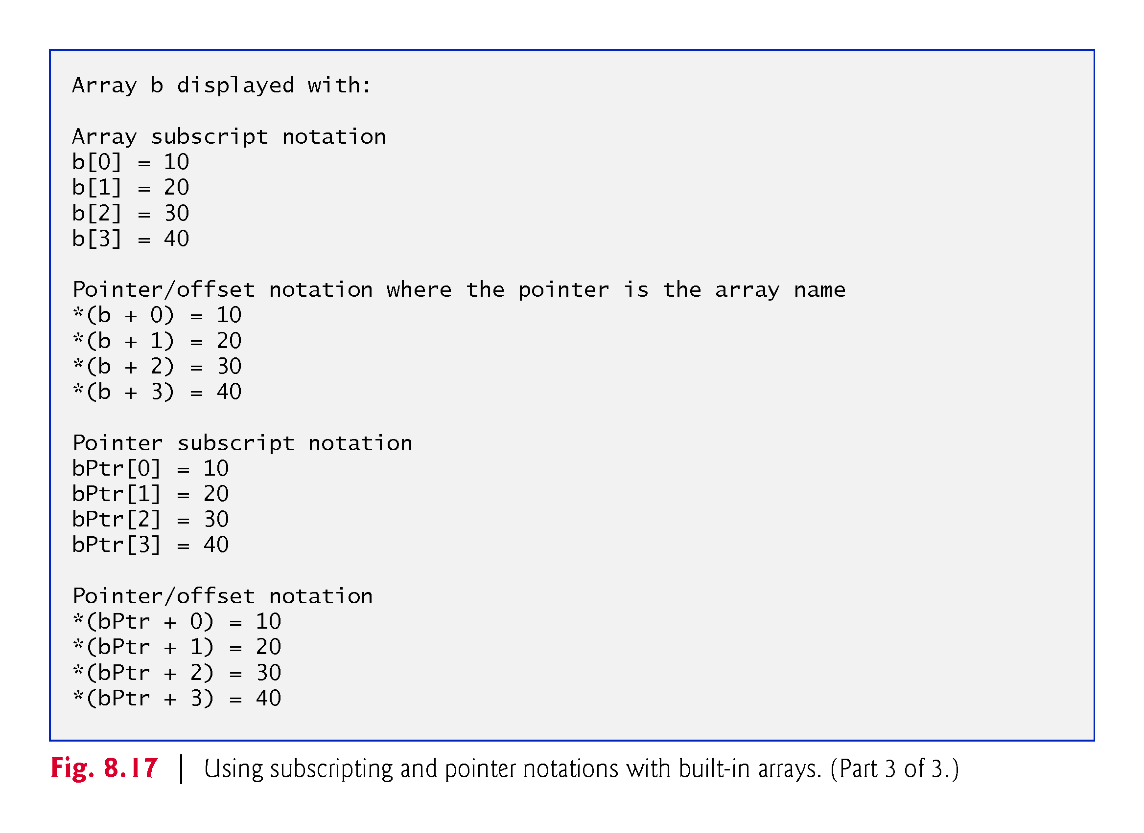

Slide 77
8.10 Pointer-Based Strings
This section introduces C-style, pointer-based strings, which we’ll simply call C strings.
C++’s string class is preferred
it eliminates many of the security problems that can be caused by manipulating C strings.
We cover C strings for a deeper understanding of arrays, and because there are some cases in which C string processing is required.
Also, if you work with legacy C and C++ programs, you’re likely to encounter pointer-based strings.

Slide 78
8.10 Pointer-Based Strings (cont.)
Characters and Character Constants
Characters are the fundamental building blocks of C++ source programs.
Character constant
An integer value represented as a character in single quotes.
The value of a character constant is the integer value of the character in the machine’s character set.

Slide 79
8.10 Pointer-Based Strings (cont.)
Strings
A string is a series of characters treated as a single unit.
May include letters, digits and various special characters such as +, -, *, /and $.
String literals, or string constants, in C++ are written in double quotation marks

Slide 80
8.10 Pointer-Based Strings (cont.)
Pointer-Based Strings
A pointer-based string is a built-in array of characters ending with a null character ('\0').
A string is accessed via a pointer to its first character.
The sizeof a string literal is the length of the string including the terminating null character.

Slide 81
8.10 Pointer-Based Strings (cont.)
Accessing Characters in a C String
Because a C string is a built-in array of characters, we can access individual characters in a string directly with array subscript notation.

Slide 82
8.10 Pointer-Based Strings (cont.)
Reading Strings into Built-In Arrays of char with cin
A string can be read into a built-in array of chars using stream extraction with cin.
The setw stream manipulator can be used to ensure that the string read into word does not exceed the size of the built-in array.
Applies only to the next value being input.

Slide 83
8.10 Pointer-Based Strings (cont.)
Reading Lines of Text into Built-In Arrays of char with cin.getline
In some cases, it’s desirable to input an entire line of text into a built-in array of chars.
For this purpose, the cin object provides the member function getline, which takes three arguments—a built-in array of chars in which the line of text will be stored, a length and a delimiter character.
The function stops reading characters when the delimiter character '\n' is encountered, when the end-of-file indicator is entered or when the number of characters read so far is one less than the length specified in the second argument.
The third argument to cin.getline has '\n' as a default value.

Slide 84
8.11 Note About Smart Pointers
Later in the book, we introduce dynamic memory management with pointers, which allows you at execution time to create and destroy objects as needed.
Improperly managing this process is a source of subtle errors.
We’ll discuss “smart pointers,” which help you avoid dynamic memory management errors by providing additional functionality beyond that of built-in pointers.

